Slide 1




prioritizr Systematic conservation planning in R R
Jeffrey Hanson
jeffrey.hanson@uqconnect.edu.au
prioritizr.net

Slide 2
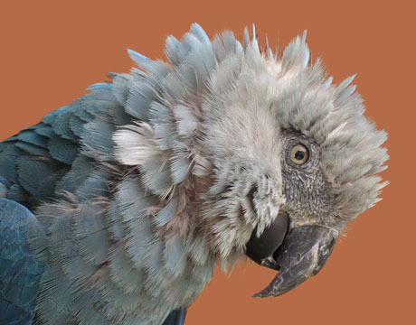
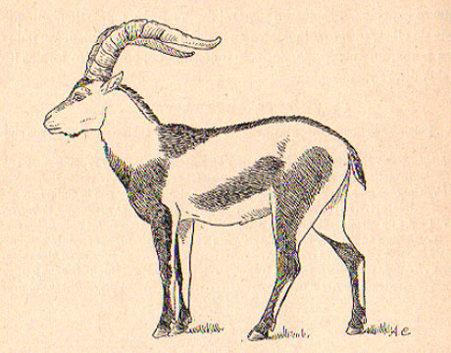
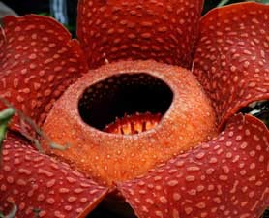
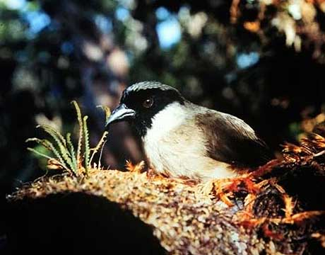
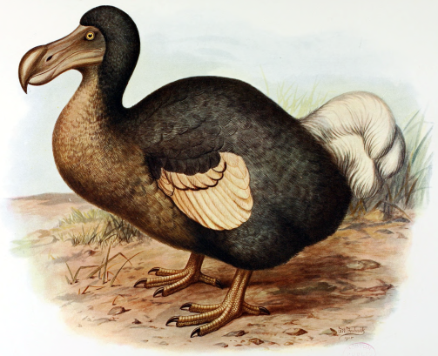
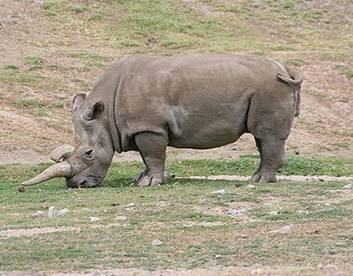
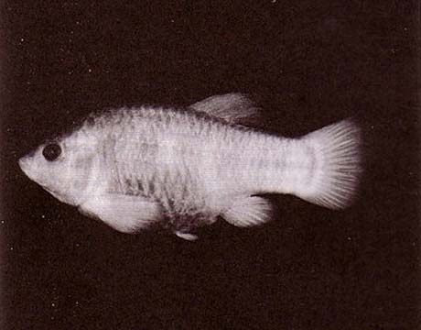
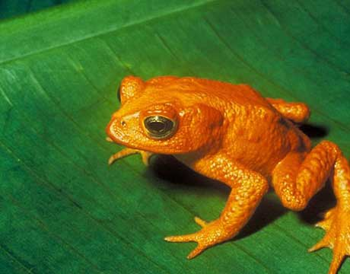
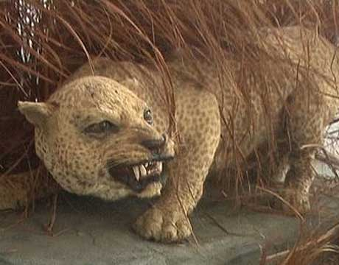
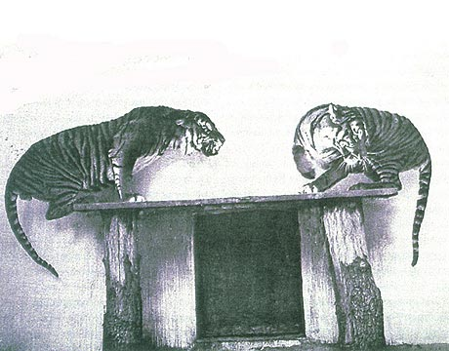
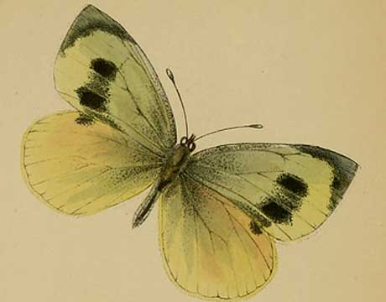
Global biodiversity crisis
Notes:
- high extinction rate
- conservation aims to maintain existing patterns of biodiversity and the processes that sustain them
- areas set aside to preserve biodiversity, and spearhead direct management actions

Slide 3
What should we do?

Slide 4
What should we do
to achieve conservation?

Slide 5
What actions should we do to achieve conservation?

Slide 6
What actions should we do,
and where should we do them
to achieve conservation?

Slide 7
What actions should we do,
and where should we do them,
and when should we do them,
to achieve conservation?

Slide 8
What actions should we do,
and where should we do them,
and when should we do them,
to achieve conservation
in a cost-effective manner?

Slide 9
Decision science
Goal: what is our vision for the future?
Objective: what quantity are we maximizing/minimizing to help achieve the goal?
Constraints: what things must our solution do to help achieve the goal?
Decisions: what actions could we do to maximize/minimize the objective?

Slide 10
Decision science
Goal: what is our vision for the future?
Objective: what quantity are we maximizing/minimizing to help achieve the goal?
Constraints: what things must our solution do to help achieve the goal?
Decisions: what actions could we do to maximize/minimize the objective?

Slide 11
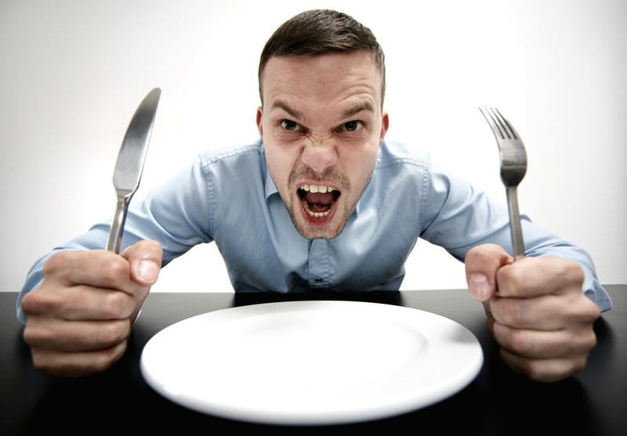
Case-study: Sandwich

Slide 12
Case-study: Sandwich
Goal: Best sandwich experience
Objective: Maximize taste
Constraints: must have bread, number of calories, cost of ingredients
Decisions: what ingredients shall I use?

Slide 13
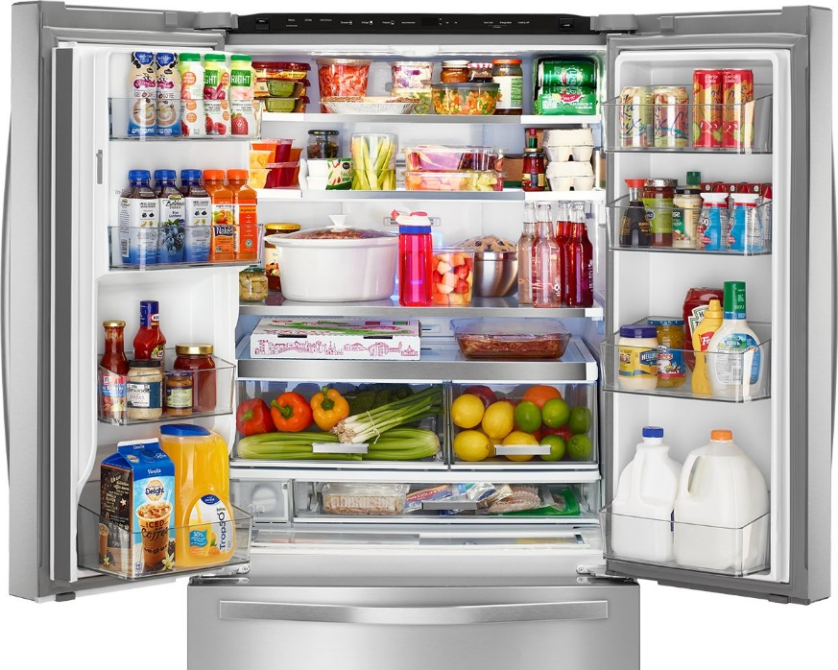
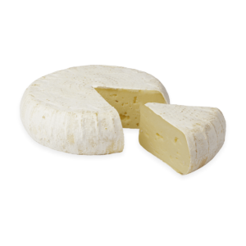
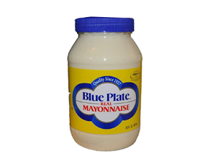
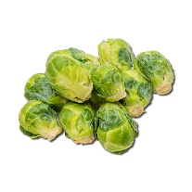
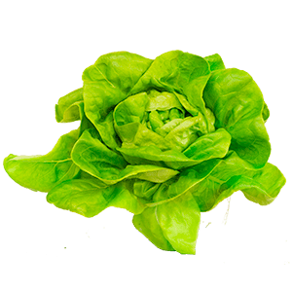

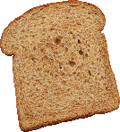

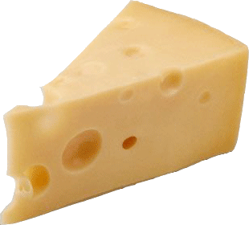

Slide 14
Maximize taste:
+1
+50
+20
+40
+3
+1
+8
-1

Slide 15
Maximize taste:
+1
+50
+20
+40
+3
+1
+8
-1
Constraint 1: must 2 bread slices
+1
+0
+0
+0
+0
+0
+0
+0
=1

Slide 16
Maximize taste:
+1
+50
+20
+40
+3
+1
+8
-1
Constraint 1: must 2 bread slices
+1
+0
+0
+0
+0
+0
+0
+0
=1
Constraint 2: calories (C per serving)
+70
+145
+380
+299
+15
+680
+24
43
≤235

Slide 17
Maximize taste:
+1
+50
+20
+40
+3
+1
+8
-1
Constraint 1: must 2 bread slices
+1
+0
+0
+0
+0
+0
+0
+0
=1
Constraint 2: calories (C per serving)
+70
+145
+380
+299
+15
+680
+24
43
≤235
Constraint 3: budget (€ per serving)
+0.21
+2.5
+0.12
+0.84
+0.04
+0.04
+0.08
+0.07
≤2.75

Slide 18
Maximize taste:
+1
+50
+20
+40
+3
+1
+8
-1
Constraint 1: must 2 bread slices
+1
+0
+0
+0
+0
+0
+0
+0
=1
Constraint 2: calories (C per serving)
+70
+145
+380
+299
+15
+680
+24
43
≤235
Constraint 3: budget (€ per serving)
+0.21
+2.5
+0.12
+0.84
+0.04
+0.04
+0.08
+0.07
≤2.75

Slide 19
Maximize taste:
+1
+50
+20
+40
+3
+1
+8
-1
Constraint 1: must 2 bread slices
+1
+0
+0
+0
+0
+0
+0
+0
=1
Constraint 2: calories (C per serving)
+70
+145
+380
+299
+15
+680
+24
43
≤235
Constraint 3: budget (€ per serving)
+0.21
+2.5
+0.12
+0.84
+0.04
+0.04
+0.08
+0.07
≤2.75

Slide 20

Maximize taste:
+1
+50
+20
+40
+3
+1
+8
-1
Constraint 1: must 2 bread slices
+1
+0
+0
+0
+0
+0
+0
+0
=1
Constraint 2: calories (per serving)
+70
+145
+380
+299
+15
+680
+24
43
≤235
Constraint 3: budget (€ per serving)
+0.21
+2.5
+0.12
+0.84
+0.04
+0.04
+0.08
+0.07
≤2.75

Slide 21
Maximize taste:
+1
+50
+20
+40
+3
+1
+8
+20
Constraints 2--3
Constraint 4: mayo + lettuce combination
+0
+0
+0
+0
+0
+1
+0
-1
≥0
+0
+0
+0
+0
+1
+0
+0
-1
≥0

Slide 22





Case-study: Reserve design
Goal: conserve biodiversity
Objective: min. # of islands
Constraints: sufficient habitat for each species
Decisions: which places should be protected?

Slide 24
1
2
3
4
5
6
7
8
9

Slide 25
1
2
3
4
5
6
7
8
9
1
2
3
4
5
6
7
8
9

Slide 26
1
2
3
4
5
6
7
8
9

Slide 27
Min €:
+1
+1
+1
+1
+1
+1
+1
+1
+1
1
2
3
4
5
6
7
8
9

Slide 28
2
Min €:
+1
+1
+1
+1
+1
+1
+1
+1
+1
1
2
3
4
5
6
7
8
9

Slide 29
Min €:
+1
+1
+1
+1
+1
+1
+1
+1
+1
1
2
3
4
5
6
7
8
9
+1
+1
1
2
3
4
5
6
7
8
9

Slide 30
Min €:
+1
+1
+1
+1
+1
+1
+1
+1
+1
1
2
3
4
5
6
7
8
9
+1
+1
+1
1
2
3
4
5
6
7
8
9

Slide 31
Min €:
+1
+1
+1
+1
+1
+1
+1
+1
+1
+1
1
2
3
4
5
6
+1
7
8
9
+1
+1
+1
1
2
3
4
5
6
7
8
9

Slide 32
Min €:
+1
+1
+1
+1
+1
+1
+1
+1
+1
+1
+1
+1
+1
+1
+1
+1
+1
+1
+1
+1
+1
1
2
3
4
5
6
7
8
9

Slide 33
Min €:
+1
+1
+1
+1
+1
+1
+1
+1
+1
+1
≥ 1
+1
+1
≥ 1
+1
+1
≥ 1
+1
≥ 1
+1
+1
+1
+1
+1
+1
≥ 1
1
2
3
4
5
6
7
8
9

Slide 34
Min €:
+1
+1
+1
+1
+1
+1
+1
+1
+1
+1
≥ 1
+1
+1
≥ 1
+1
+1
≥ 1
+1
≥ 1
+1
+1
+1
+1
+1
+1
≥ 1
1
2
3
4
5
6
7
8
9

Slide 35
1
2
3
4
5
6
7
8
9
1
2
3
4
5
6
7
8
9

Slide 36
Integer linear problem
Min:
+7
+2
+5
+9
+1
+0
+1
+1
≥ 1
+1
+1
+0
+1
≥ 1
V. types
B
B
B
B
Upper bound
1
1
1
1
Lower bound
0
0
0
0
Solution
0
1
1
0

Slide 37
Model sense
Min:
+7
+2
+5
+9
+1
+0
+1
+1
≥ 1
+1
+1
+0
+1
≥ 1
V. types
B
B
B
B
Upper bound
1
1
1
1
Lower bound
0
0
0
0
Solution
0
1
1
0

Slide 38
Objective
Min:
+7
+2
+5
+9
+1
+0
+1
+1
≥ 1
+1
+1
+0
+1
≥ 1
V. types
B
B
B
B
Upper bound
1
1
1
1
Lower bound
0
0
0
0
Solution
0
1
1
0

Slide 39
Constraints
Min:
+7
+2
+5
+9
+1
+0
+1
+1
≥ 1
+1
+1
+0
+1
≥ 1
V. types
B
B
B
B
Upper bound
1
1
1
1
Lower bound
0
0
0
0
Solution
0
1
1
0

Slide 40
Constraints
Sense
Min:
+7
+2
+5
+9
+1
+0
+1
+1
≥ 1
Coefficients
RHS
+1
+1
+0
+1
≥ 1
V. types
B
B
B
B
Upper bound
1
1
1
1
Lower bound
0
0
0
0
Solution
0
1
1
0

Slide 41
Variables
Min:
+7
+2
+5
+9
+1
+0
+1
+1
≥ 1
+1
+1
+0
+1
≥ 1
V. types
B
B
B
B
Upper bound
1
1
1
1
Lower bound
0
0
0
0
Solution
0
1
1
0

Slide 42
Variables
Min:
+7
+2
+5
+9
+1
+0
+1
+1
≥ 1
+1
+1
+0
+1
≥ 1
V. types
B
B
B
B
Upper bound
1
1
1
1
Lower bound
0
0
0
0
Solution
0
1
1
0

Slide 43
Variables (MILP)
Min:
+7
+2
+5
+9
+1
+0
+1
+1
≥ 1
+1
+1
+0
+1
≥ 1
V. types
C
B
B
I
Upper bound
Inf
1
1
5
Lower bound
-Inf
0
1
2
Solution
0
1
1
0

Slide 44
Solution
Min:
+7
+2
+5
+9
+1
+0
+1
+1
≥ 1
+1
+1
+0
+1
≥ 1
V. types
B
B
B
B
Upper bound
1
1
1
1
Lower bound
0
0
0
0
Solution
0
1
1
0

Slide 45
Exact algorithms
Solution quality guaranteed
Solve large problems fast
Flexible
linearization tricks, e.g. piecewise objective functions, combinations of constraints

Slide 46
Workflow
Biodiversity data
Input data for solver
Economic data
Solve problem
Problem formulation
Maps
Statistics

Slide 47
Workflow
Biodiversity data
Input data for solver
Economic data
Solve problem
Problem formulation
Maps
Statistics

Slide 48
Workflow
Biodiversity data
Input data for solver
Economic data
Solve problem
Problem formulation
Maps
Statistics

Slide 49
Global biodiversity crisis
Notes:
- high extinction rate
- conservation aims to maintain existing patterns of biodiversity and the processes that sustain them
- areas set aside to preserve biodiversity, and spearhead direct management actions

Slide 50

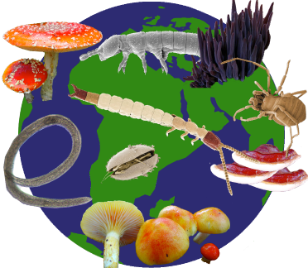
Objective
Minimize cost

Slide 51

Objective
Maximize benefit

Slide 52
Objective
Maximize benefit

Slide 53
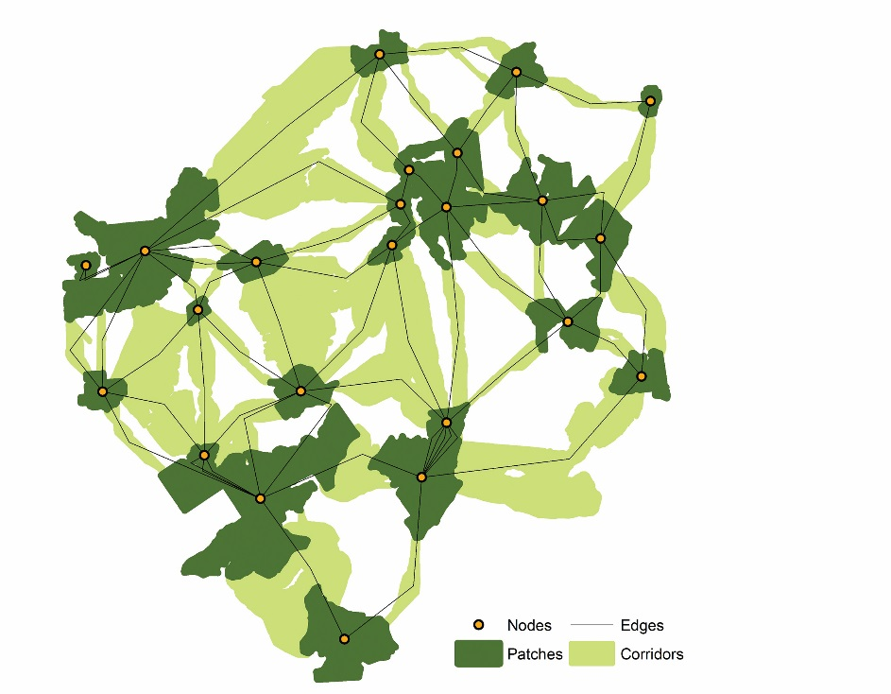
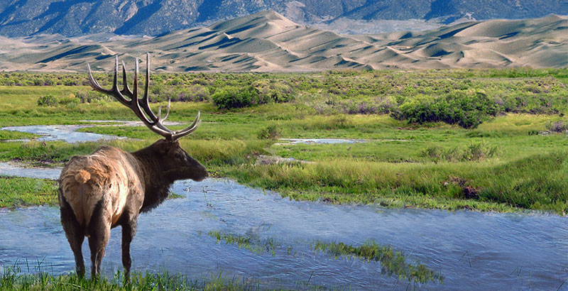
Constraints & Penalties

Slide 54
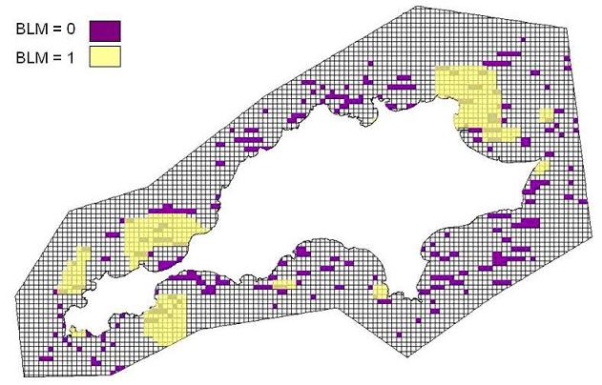
Constraints & Penalties

Slide 55
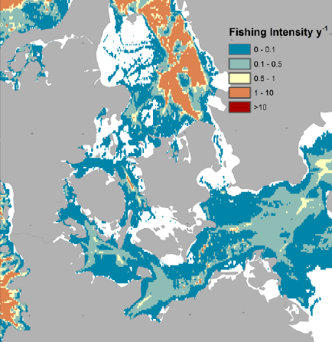
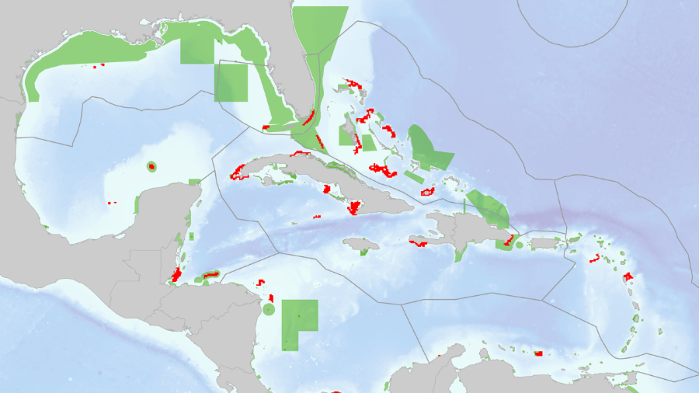
Constraints & Penalties

Slide 56
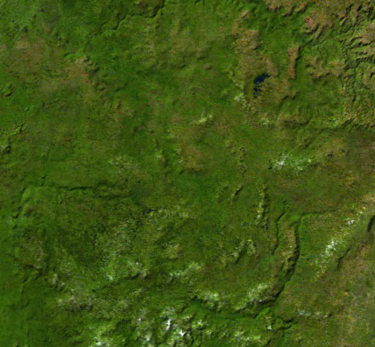
Decision type
Conserve or not?
Different amounts?
Multiple actions?

Slide 57





Solver
?
?
?
?

Slide 58

prioritizr
Human readable code
Design your problem
Solve it fast!

Slide 59
Human-readable code
Mental model
problem <- data +
objective +
constraints +
penalties +
decision type +
solver
solution <- solve(problem)

Slide 60
Human-readable code
Mental model
Code
problem <- data +
objective +
constraints +
penalties +
decision type +
solver
solution <- solve(problem)
p <- problem(areas, feats) %>%
add_min_set_objective() %>%
add_relative_targets(0.1) %>%
add_boundary_penalties(5) %>%
add_binary_decisions() %>%
add_rsymphony_solver()
solution <- solve(p)

Slide 61
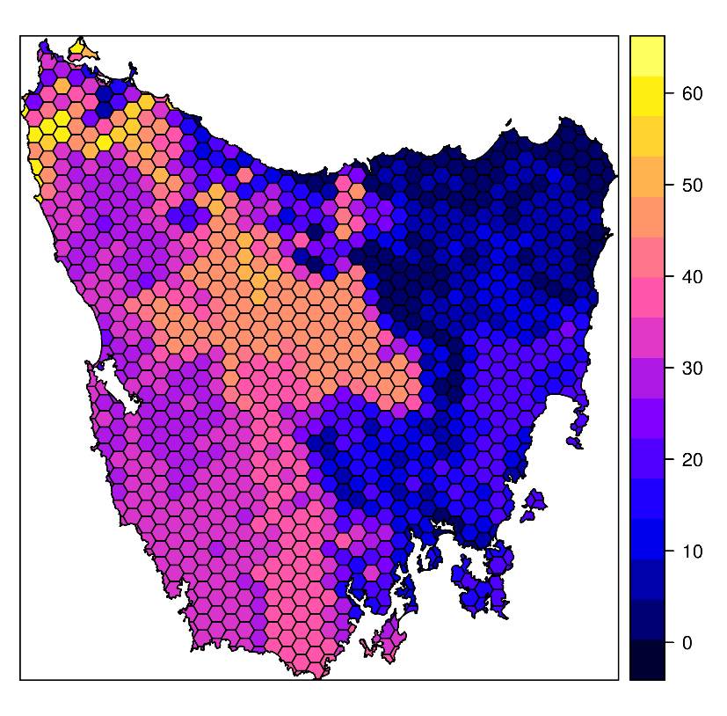
Design your problem
Study area: Tasmania, Australia
Planning units: 1130 hexagons
Features: 63 vegetation types

Slide 62
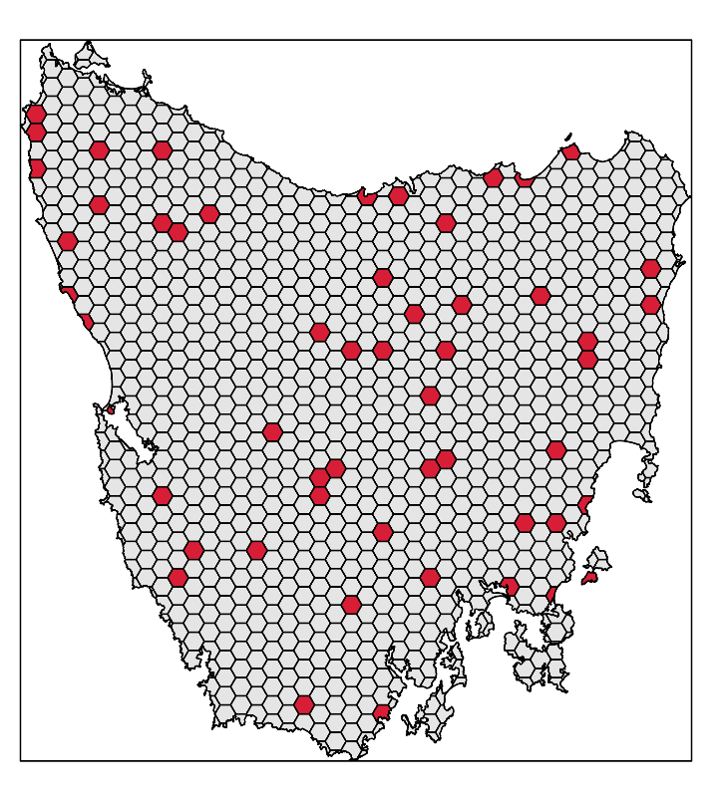
Design your problem
problem(tas_pu, tas_features,
"cost") %>%
add_min_set_objective() %>%
add_relative_targets(0.1) %>% add_binary_decisions() %>%
add_gurobi_solver(gap = 0) %>% solve()

Slide 63
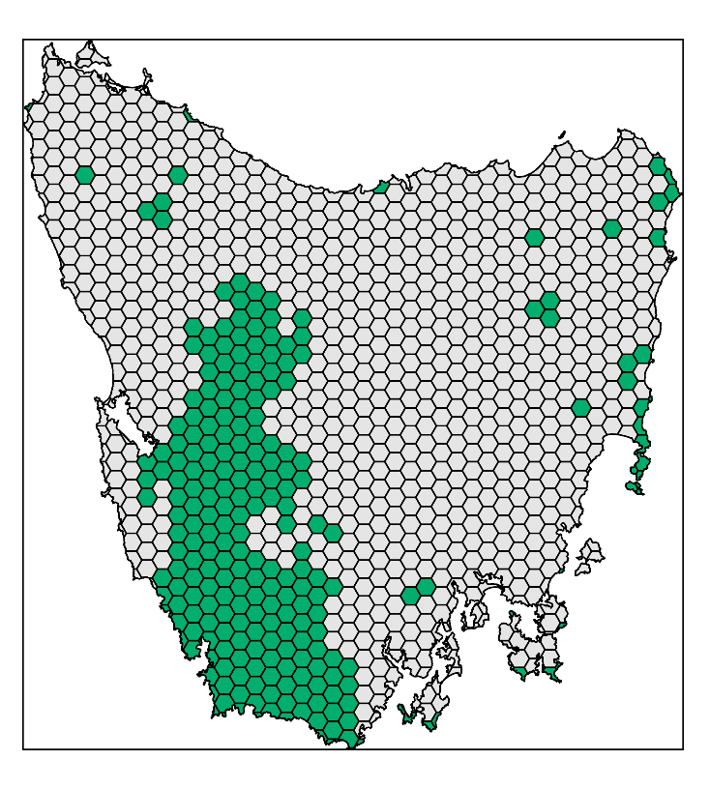
Design your problem
problem(tas_pu, tas_features,
"cost") %>%
add_min_set_objective() %>%
add_relative_targets(0.1) %>% add_locked_in_constraints("in") %>%
add_binary_decisions() %>%
add_gurobi_solver(gap = 0) %>% solve()

Slide 64
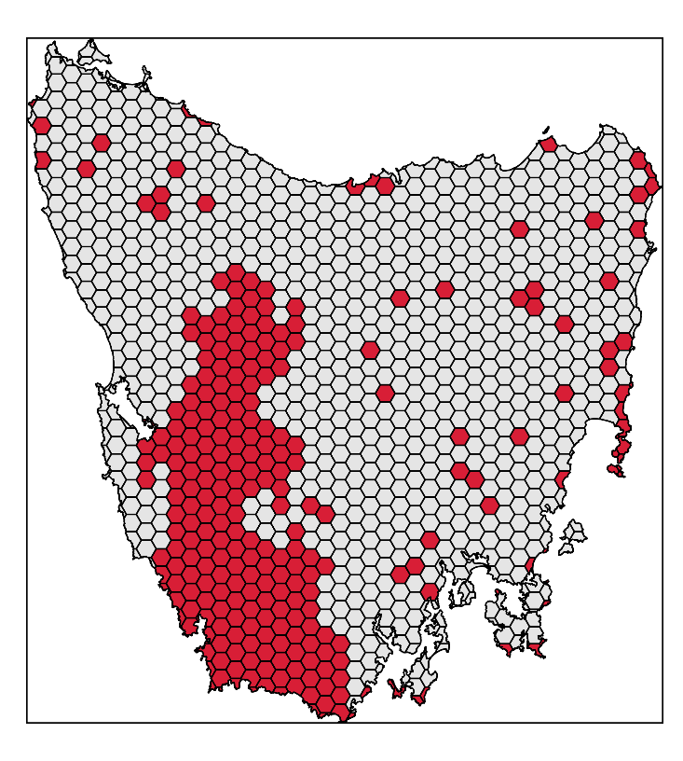
Design your problem
problem(tas_pu, tas_features,
"cost") %>%
add_min_set_objective() %>%
add_relative_targets(0.1) %>% add_locked_in_constraints("in") %>%
add_binary_decisions() %>%
add_gurobi_solver(gap = 0) %>% solve()

Slide 65
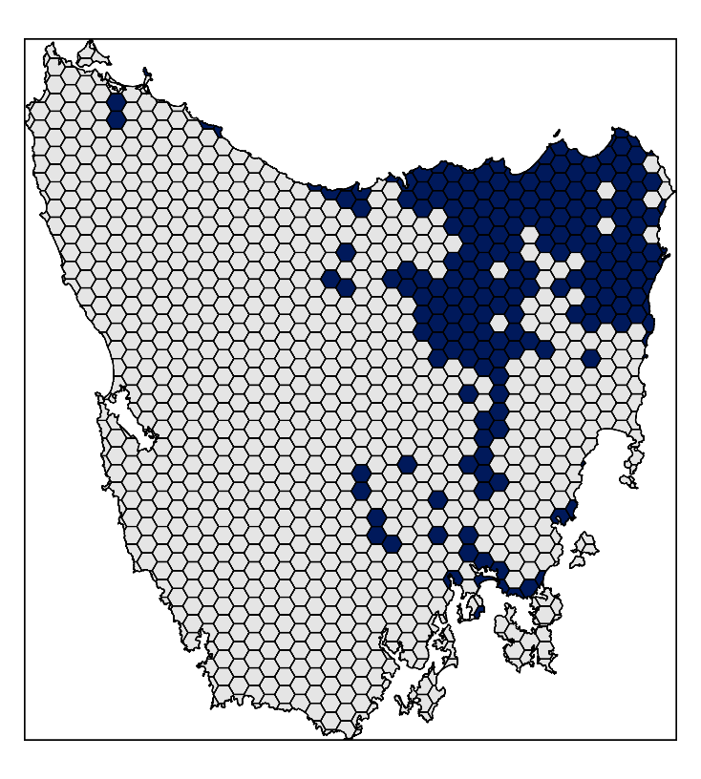
Design your problem
problem(tas_pu, tas_features,
"cost") %>%
add_min_set_objective() %>%
add_relative_targets(0.1) %>% add_locked_in_constraints("in") %>%
add_locked_out_constraints("out") %>%
add_binary_decisions() %>%
add_gurobi_solver(gap = 0) %>% solve()

Slide 66
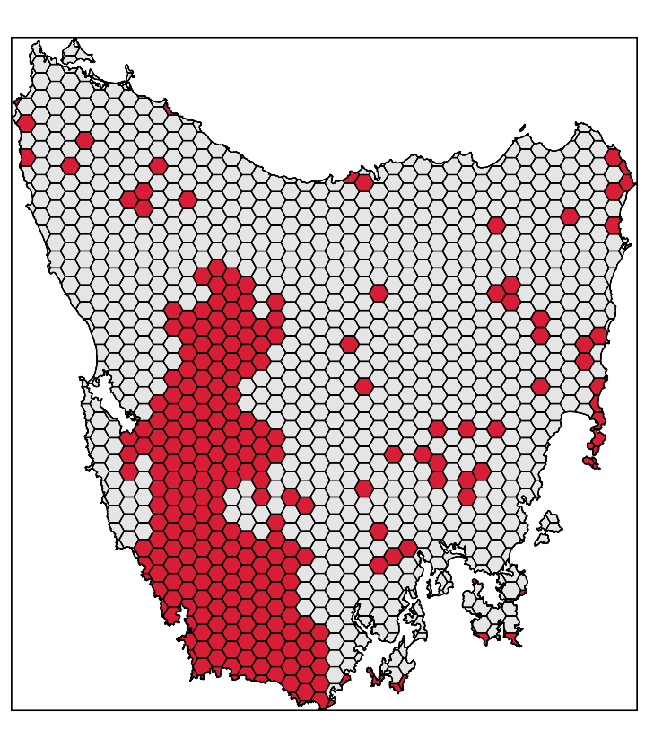
Design your problem
problem(tas_pu, tas_features,
"cost") %>%
add_min_set_objective() %>%
add_relative_targets(0.1) %>% add_locked_in_constraints("in") %>%
add_locked_out_constraints("out") %>%
add_binary_decisions() %>%
add_gurobi_solver(gap = 0) %>% solve()

Slide 67
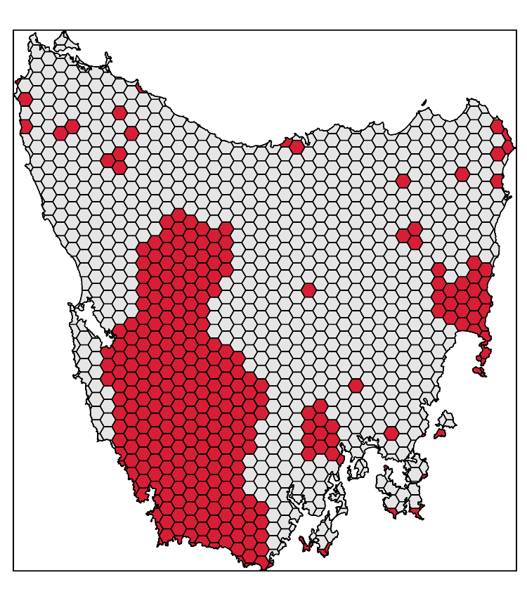
Design your problem
problem(tas_pu, tas_features,
"cost") %>%
add_min_set_objective() %>%
add_relative_targets(0.1) %>% add_locked_in_constraints("in") %>%
add_locked_out_constraints("out") %>%
add_boundary_penalties(0.01, 0.5) %>%
add_binary_decisions() %>%
add_gurobi_solver(gap = 0) %>% solve()

Slide 68
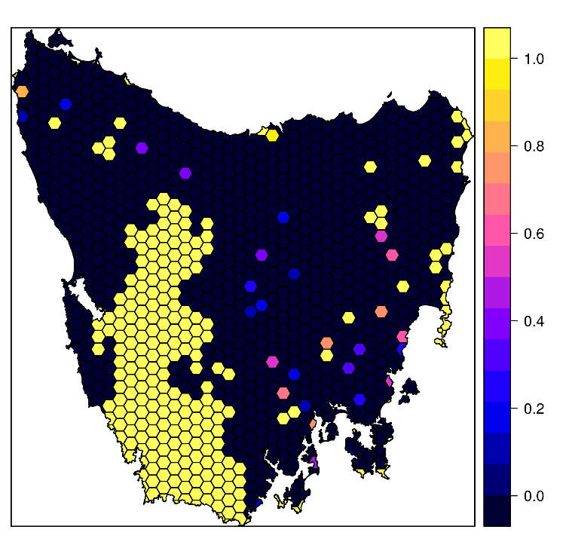
Design your problem
problem(tas_pu, tas_features,
"cost") %>%
add_min_set_objective() %>%
add_relative_targets(0.1) %>% add_locked_in_constraints("in") %>%
add_locked_out_constraints("out") %>%
add_proportion_decisions() %>%
add_gurobi_solver(gap = 0) %>% solve()

Slide 69
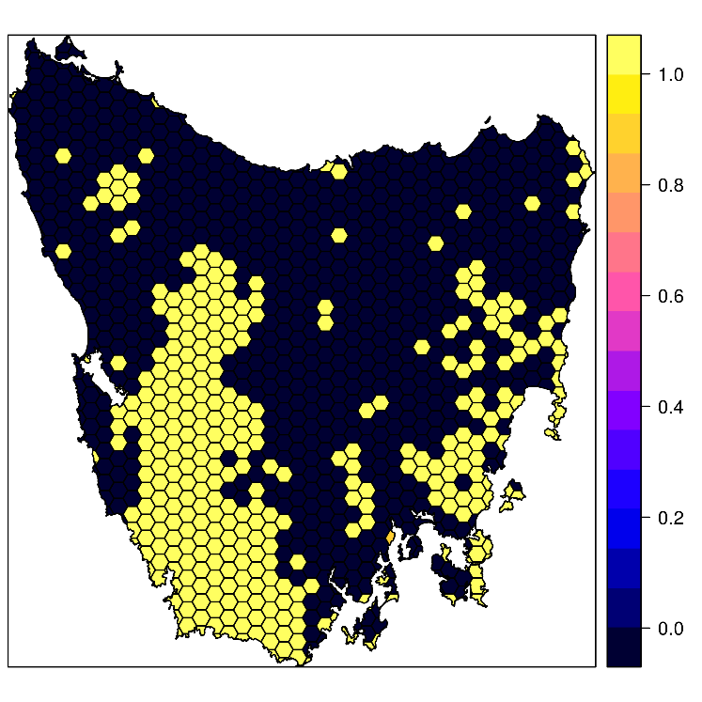
Design your problem
problem(tas_pu, tas_features,
"cost") %>%
add_max_utility_objective(budget) %>%
add_locked_in_constraints("in") %>%
add_locked_out_constraints("out") %>%
add_proportion_decisions() %>%
add_gurobi_solver(gap = 0) %>% solve()

Slide 70
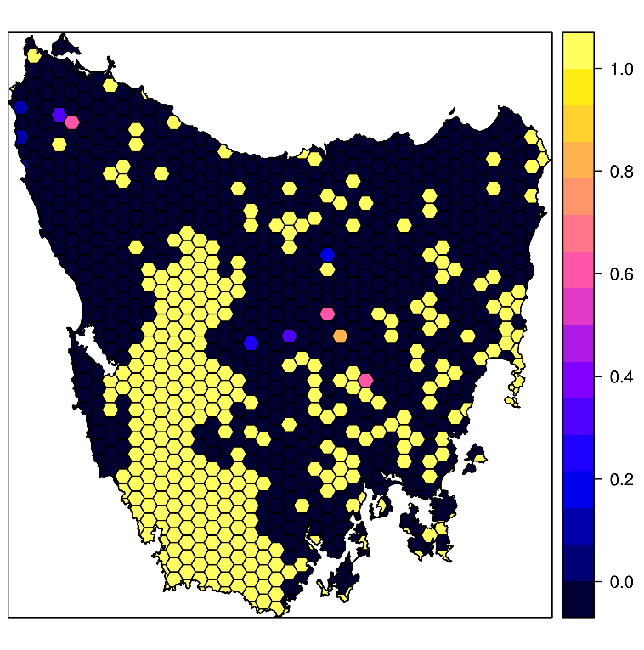
Design your problem
problem(tas_pu, tas_features,
"cost") %>%
add_max_features_objective(budget)%>%
add_relative_targets(0.1) %>% add_locked_in_constraints("in") %>%
add_locked_out_constraints("out") %>%
add_proportion_decisions() %>%
add_gurobi_solver(gap = 0) %>% solve()

Slide 71
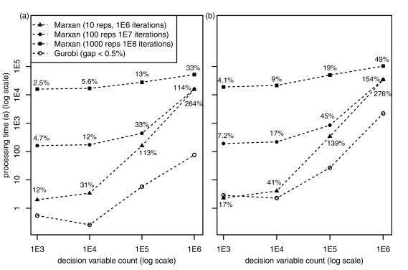
Solve it fast!
Beyer et al. (2016)

Slide 72
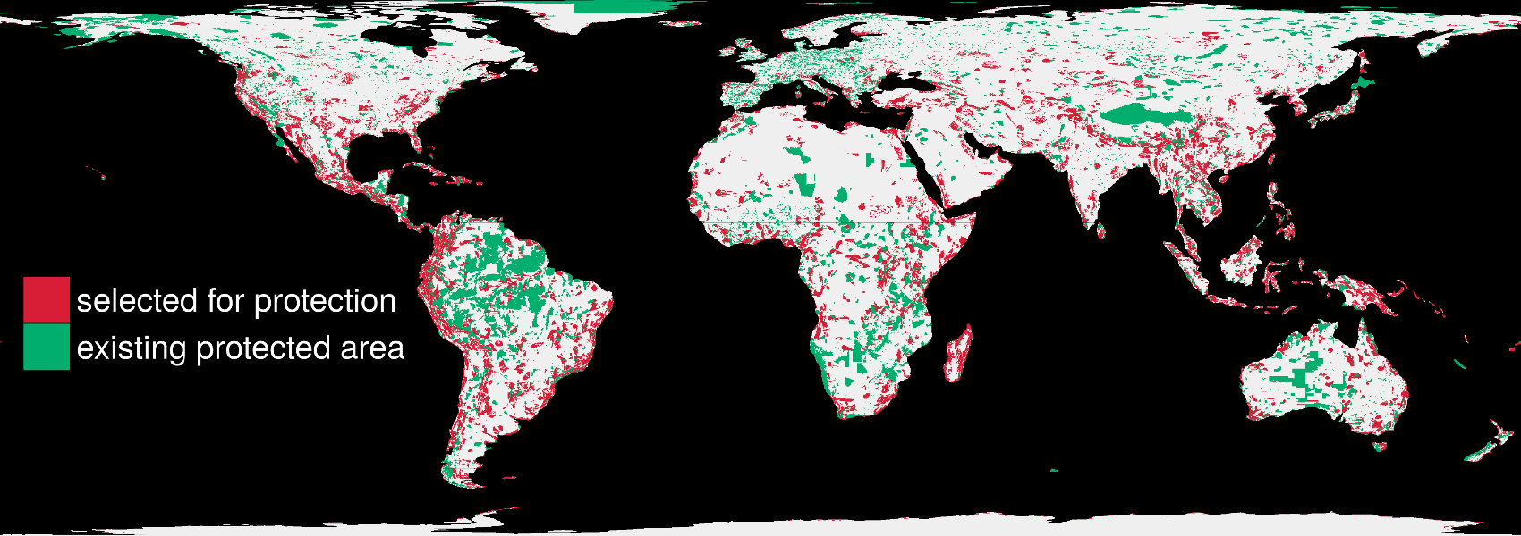
Solve it fast!
1.5 million planning units & 22,644 species: 76 minutes

Slide 73

Marxan
prioritizr
Completely free
Lots of resources
Solves a specific problem
100k planning units limit
SPF calibration
Solution quality unknown
Need to run 1k+ times
Point-and-click
Free but you really want gurobi
Documented (not as well)
Solves lots of different problems
>5M planning units
No SPF calibration
Solution quality guaranteed
Run once
Minor programming skills
There is no clear winner: trade-offs!

Slide 74
What you will do today
Explain the exercises
Explain manual formats (text, code vs output)
Explain questions/answers
Explain gurobi vs. lpsymphony

Slide 75
Getting help
prioritizr website
https://prioritizr.net
RDocumentation
https://www.rdocumentation.org
Geocompr
https://geocompr.robinlovelace.net/

Slide 76



jeffrey.hanson@uqconnect.edu.au
github.com/prioritizr/prioritizr
prioritizr.net

